Slide 1
Mind Matters
The Power of Mindfulness, Hardiness, and Positive Mindset
created by:
Marisa Vicere, MBA
Jana Marie Foundation
with support from:
The Center for Resilience
A Mindful Village

Slide 2

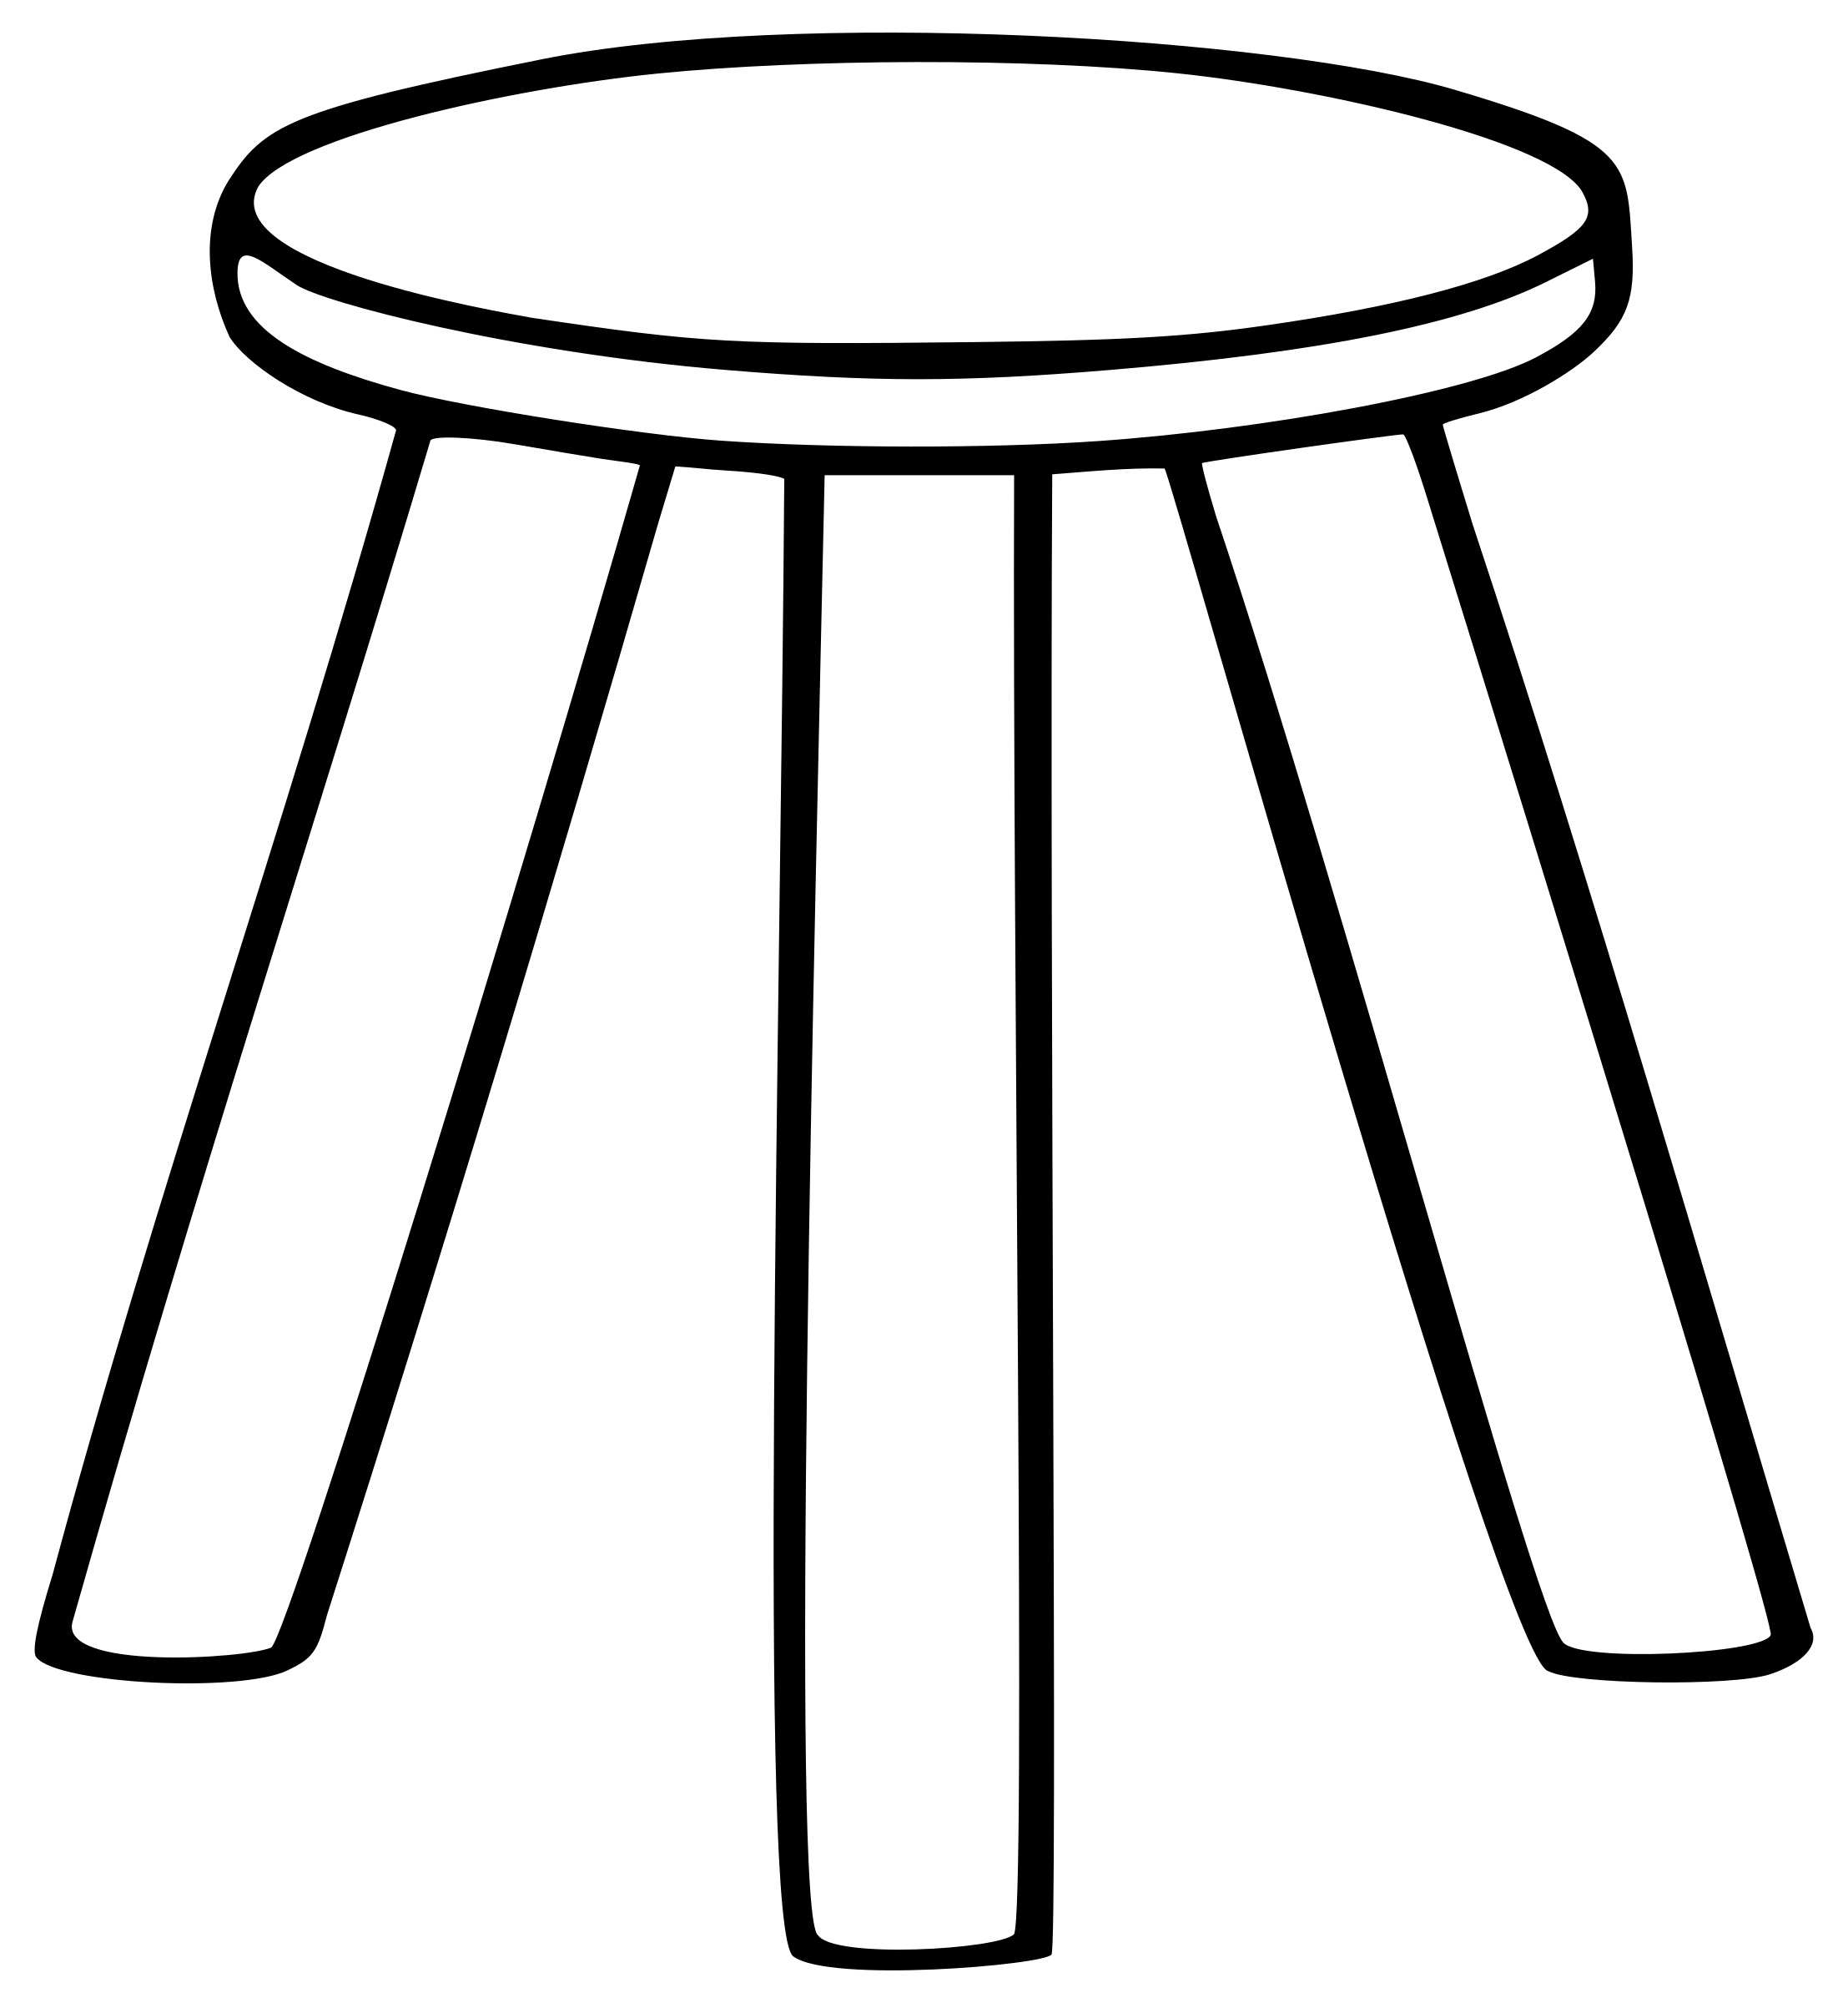

Building resilience can decrease stress and increase wellness
Stress Defined
The Pillars of Resilience
A New Outlook

Slide 3


Stress is any change, positive or negative, to which a young person must adapt.
(Joyce V. Fetro, Personal & Social Skills, 2000)
Stress is a natural part of every person’s life.

Slide 4
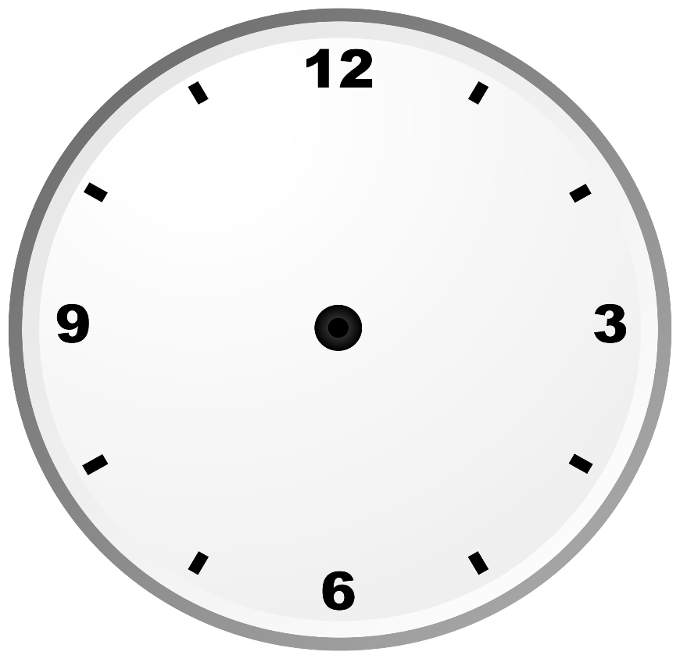
Multi-tasking results in a loss of time and productivity
Phone checked every 6 minutes

Slide 5
Multi-tasking results in a loss of time and productivity
10 times per hour

Slide 6
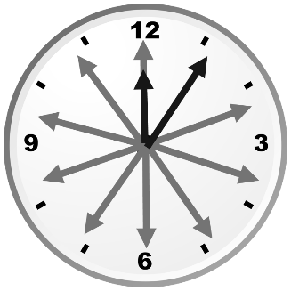
Multi-tasking results in a loss of time and productivity
150 times per 15-hour day

Slide 7
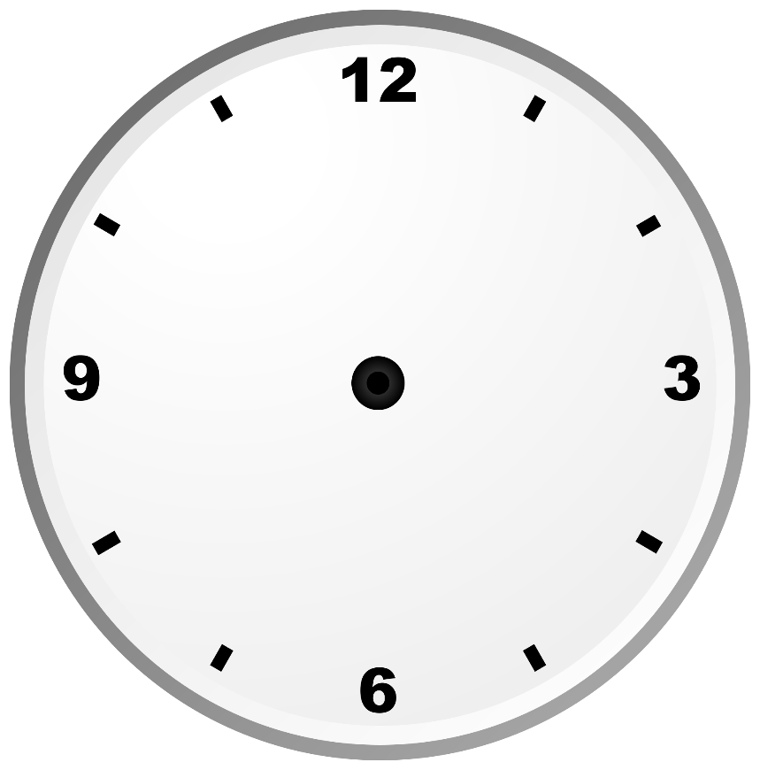
Multi-tasking results in a loss of time and productivity
64 seconds to refocus

Slide 8
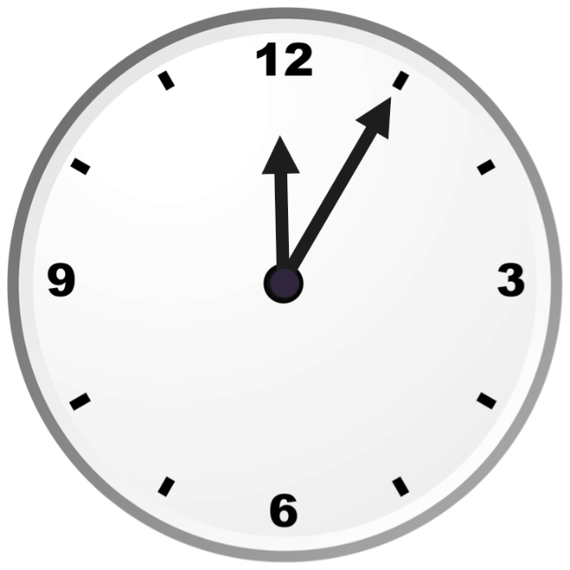
Multi-tasking results in a loss of time and productivity
2.56 hours lost each day

Slide 9
Multi-tasking results in a loss of time and productivity
MULTI-TASKING CHALLENGE
I AM AN EXCELLENT MULTITASKER
1 2 3 4 5 6 7 8 9 10 11 12 13 14 15 16 17 18 19 20 21 22 23 24 25

Slide 10
Multi-tasking results in a loss of time and productivity
MULTI-TASKING CHALLENGE
N
A
A
M
I
3
1
4
2

Slide 11



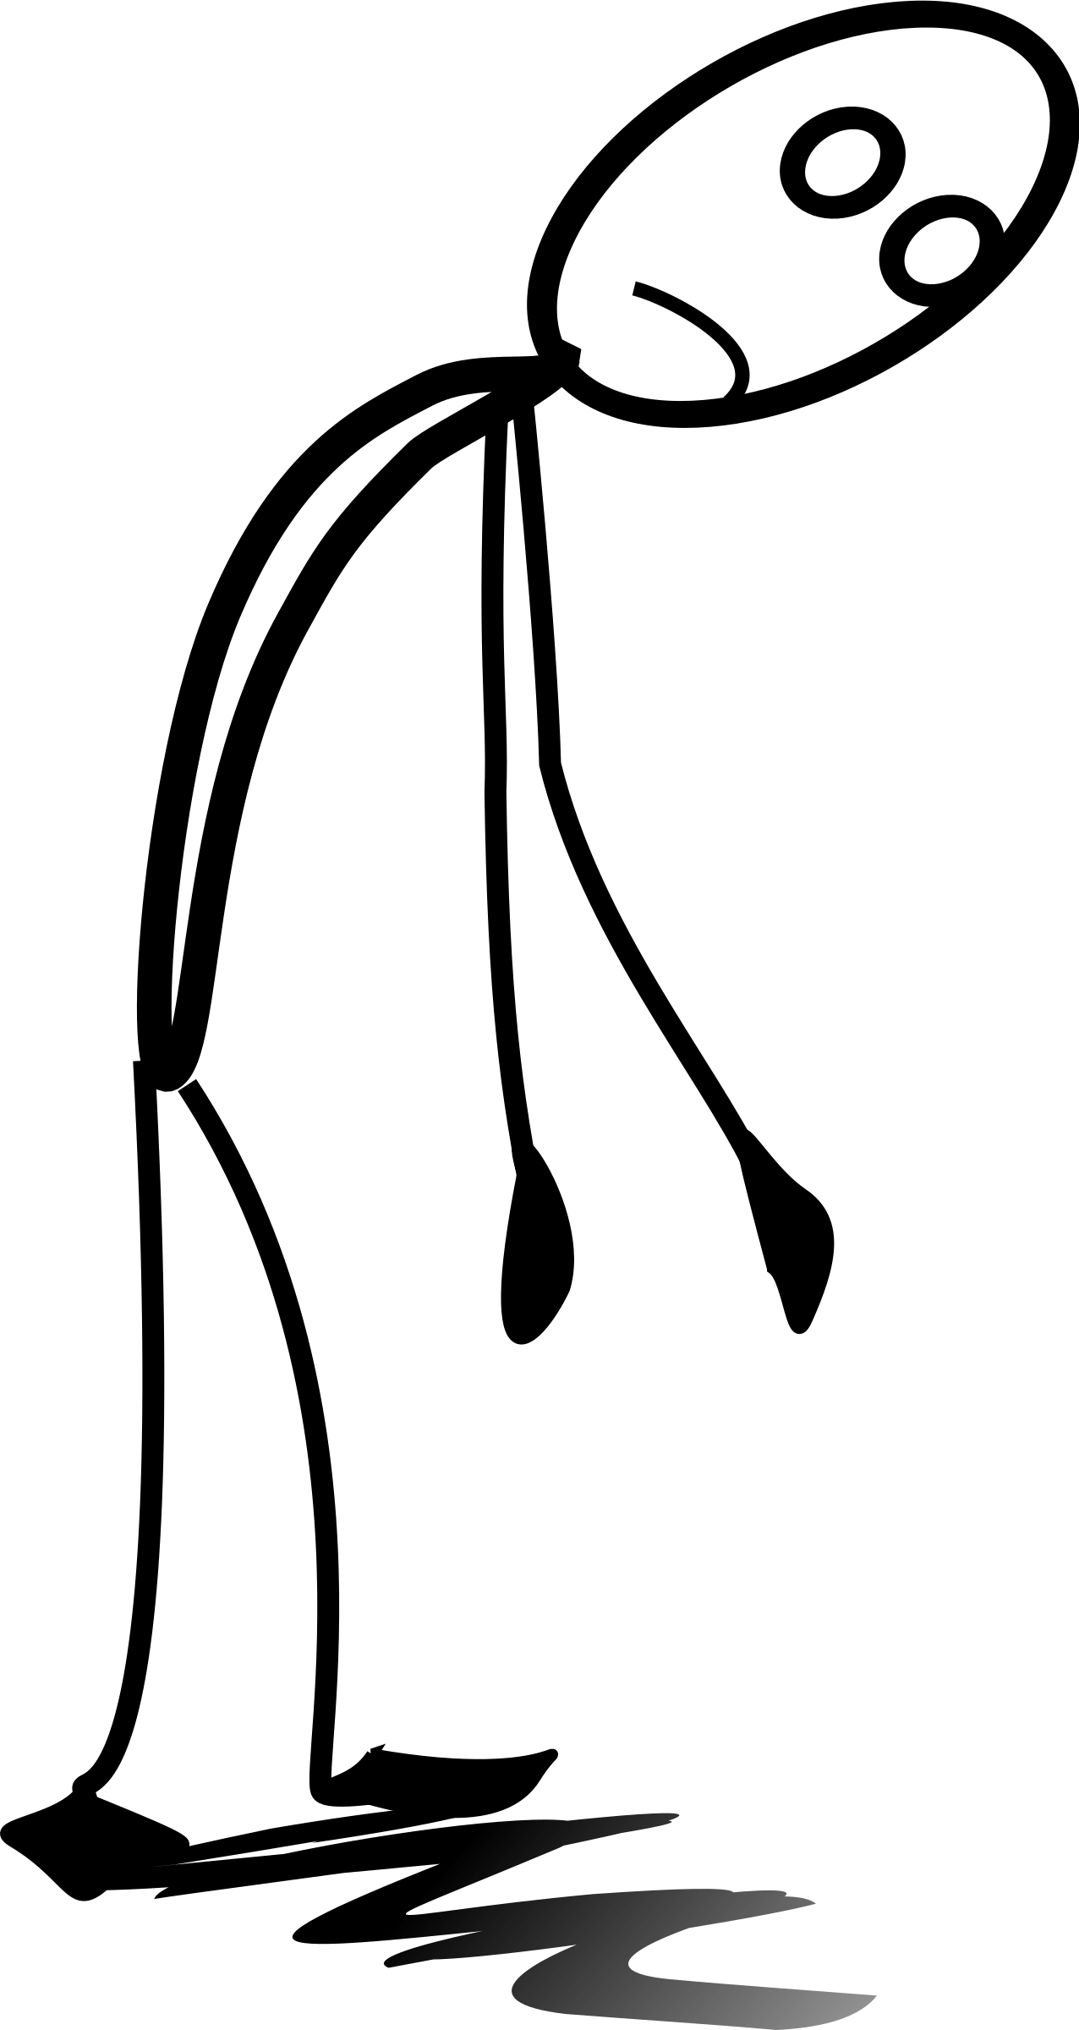
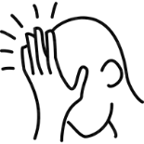
Multi-tasking results in a loss of time and productivity
Increase in errors
Increase in time taken to complete task
Decrease in quality
Increase in fatigue
Increase in frustration
So what can you do to help with
time management in your life?

Slide 12



KNOW YOUR RESOURCES
School Counselors
Trusted Adults
Safe to Say Something
Other community Resources
National Suicide Prevention Lifeline
1-800-273-8255
Crisis Text Line
Text PA to 741741
Notes:
Stop here for day 1.

Slide 13
Building resilience can decrease stress and increase wellness
Stress Defined
The Pillars of Resilience
A New Outlook

Slide 14
Mindfulness, hardiness, positive mindset: The pillars of resilience
Resilience
Resilience is the process of adapting well in the face of adversity, trauma, tragedy, threats, or significant sources of stress… It means “bouncing back” from difficult experiences.
Hardiness
-American Psychological Association
Positive Mindets
Mindfulness

Slide 15
Mindfulness, hardiness, positive mindset: The pillars of resilience
Resilience
Hardiness
Positive Mindets
Mindfulness

Slide 16

Mindfulness, hardiness, positive mindset: The pillars of resilience

Slide 17
Mindfulness, hardiness, positive mindset: The pillars of resilience
Mindfulness is the awareness that emerges through paying attention, on purpose, in the present moment, and nonjudgmentally, to things as they are.
-Williams, Teasdale, Segal, and Kabat-Zinn (2007)
S R
￼
Between the stimulus and the response there is a space. In that space is our power to choose our response. In our response lies our growth and freedom.
-Viktor Frankl
S A R

Slide 18



Mindfulness, hardiness, positive mindset: The pillars of resilience
Rehashing
53%
Rehearsing
47%

Slide 19

Mindfulness, hardiness, positive mindset: The pillars of resilience
Stop what you are doing
Take a mindful breath
Observe what you are doing and thinking
Proceed
￼
STOP 3-4 times per day

Slide 20
Mindfulness, hardiness, positive mindset: The pillars of resilience
Resilience
Hardiness

Slide 21
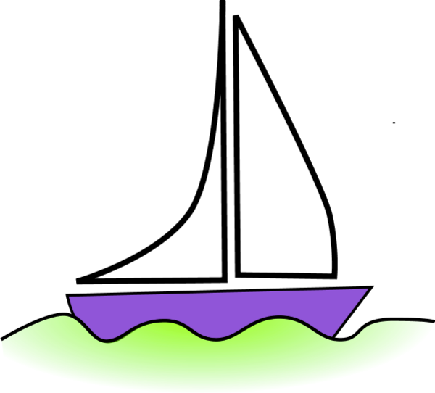
Mindfulness, hardiness, positive mindset: The pillars of resilience

Slide 22

Mindfulness, hardiness, positive mindset: The pillars of resilience
Values, Morals, Beliefs

Slide 23

Mindfulness, hardiness, positive mindset: The pillars of resilience
Staying on course
￼

Slide 24
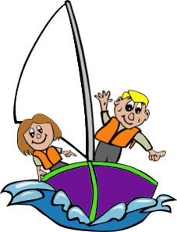
Mindfulness, hardiness, positive mindset: The pillars of resilience
Who will be your shipmates?
￼

Slide 25

Mindfulness, hardiness, positive mindset: The pillars of resilience
What will be your mantra if the waves get stronger?
￼

Slide 26
KNOW YOUR RESOURCES
School Counselors
Trusted Adults
Safe to Say Something
Other community Resources
National Suicide Prevention Lifeline
1-800-273-8255
Crisis Text Line
Text PA to 741741
Notes:
Stop here for day 2

Slide 27
Mindfulness, hardiness, positive mindset: The pillars of resilience
Resilience
Positive Mindsets

Slide 28

Mindfulness, hardiness, positive mindset: The pillars of resilience
What are your strengths?

Slide 29




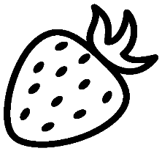



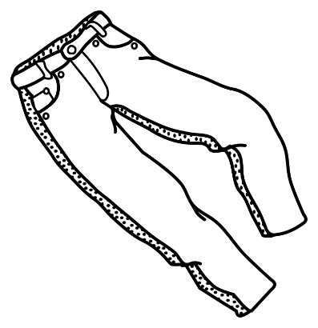

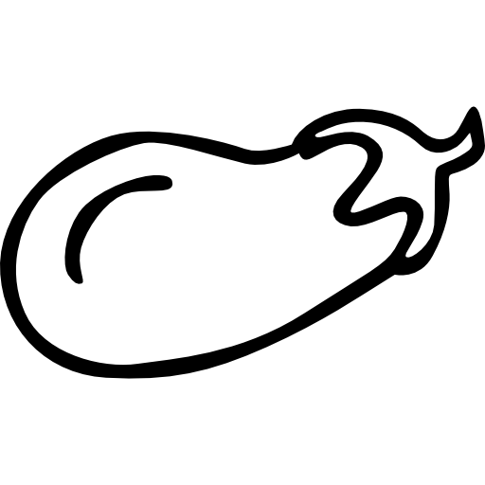





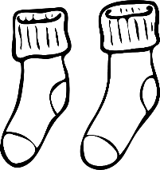
Mindfulness, hardiness, positive mindset: The pillars of resilience
A balanced wardrobe
￼
You need more than just shirts!

Slide 30

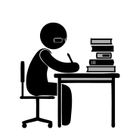
Mindfulness, hardiness, positive mindset: The pillars of resilience
Sometimes in life….

Slide 31






Mindfulness, hardiness, positive mindset: The pillars of resilience
Health and Spirituality
School and Work
Creating a balanced life
￼
Relationships
Community

Slide 32

Mindfulness, hardiness, positive mindset: The pillars of resilience
The Four Most Powerful Questions
What am I interested in now?
What am I doing to experience more of this or learn more about it?
How is that working?
What is my next step?
￼
www.centerforresilience.com

Slide 33
Mindfulness, hardiness, positive mindset: The pillars of resilience
Negative Message | Positive Message That Communicates “High Expectations”
I’ve never done it before. | It’s an opportunity to learn something new!
It’s too hard. | I will approach it differently.
I don’t have the resources I need. | I am a creative problem-solver!
I’m too lazy to get this done. | Let’s re-examine some priorities.
There’s no way it will work. | I can do this! I will think outside the box to figure out a solution.
It’s too big a change. | It’s an opportunity.
I’m not going to get any better at this. | I’ve learned other things that were hard at first. How did you do that?
￼
Adapted from: http://www.mayoclinic.org/healthy-lifestyle/stress-management/in-depth/positive-thinking/art-20043950?pg=2

Slide 34
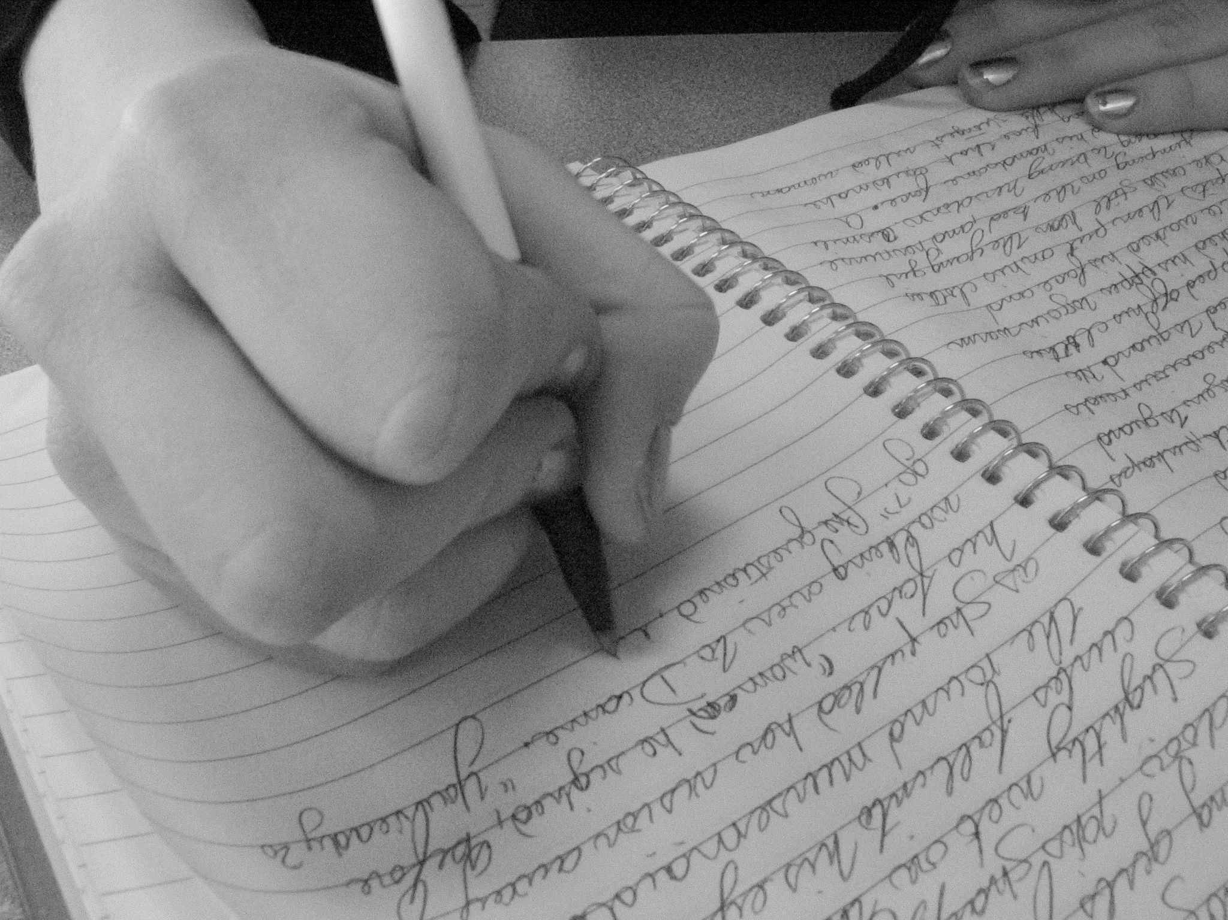
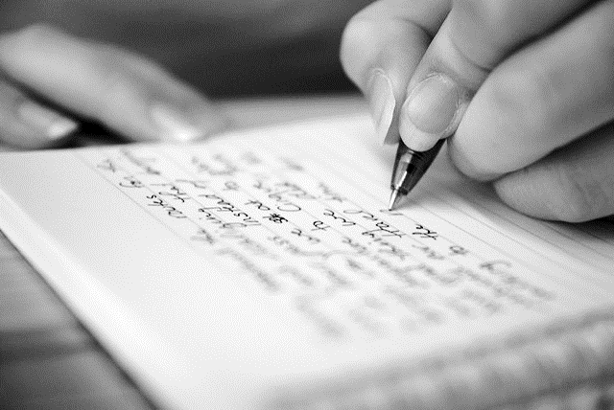
Mindfulness, hardiness, positive mindset: The pillars of resilience
￼
SERENDIPITY
EQUILIBRIUM

Slide 35
Building resilience can decrease stress and increase wellness
Stress Defined
The Pillars of Resilience
A New Outlook

Slide 36
Focus on what you can control
Five things you cannot change
By David Richo
1. Everything changes and ends
2. Things do not always go according to plan
3. Life is not always fair
4. Pain is part of life
5. People are not loving & loyal all the time
(The Five Things We Cannot Change…and the Happiness We Find by Embracing Them. 2005)
￼

Slide 37
Focus on what you can control
out of your control
In Your Control
￼
out of your control

Slide 38
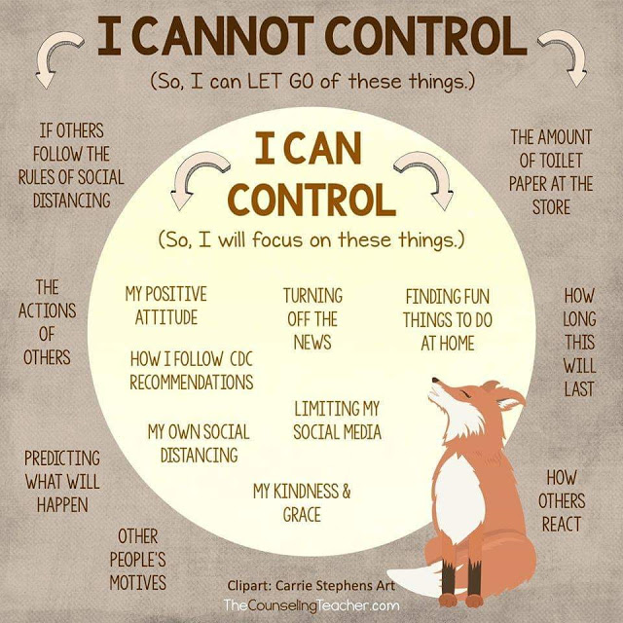
Focus on what you can control
￼

Slide 39
Resilience helps you “bounce back” from difficult experiences.
￼
And it helps you become stronger so you can continue to thrive!

Slide 40
KNOW YOUR RESOURCES
School Counselors
Trusted Adults
Safe to Say Something
Other community Resources
National Suicide Prevention Lifeline
1-800-273-8255
Crisis Text Line
Text PA to 741741

Slide 41
Additional Resources
Jana Marie Foundation
www.janamariefoundation.org
A Mindful Village
www.amindfulvillage.com
Center for Resilience
www.centerforresilience.com
Candid Conversations by Jana Marie Foundation
http://www.janamariefoundation.org/candid-conversations.html
Prevent Suicide PA
www.preventsuicidepa.org
￼

Slide 42

www.janamariefoundation.org
A SPECIAL THANKS TO:
Garrett Lee Smith Suicide Prevention in Pennsylvania Schools and Colleges Initiatives
AAUW of State College
Centre Foundation
Miraldi Consulting
Mount Nittany Health
This PowerPoint was funded under award SM061750 by the Substance Abuse and Mental Health Services Administration (SAMHSA). The views expressed herein do not necessarily reflect the official policies of the Department of Health and Human Services, nor does mention of trade names, commercial practices, or organizations imply endorsement by the U.S. Government. Additionally, the Garrett Lee Smith grant team does not specifically endorse any one model or program related to suicide prevention.

